Slide 1
Welcome to Marketing Management
Dr. Cecilia Ruvalcaba
BUSI 107 Week 12

Slide 2

Global Markets

Slide 3
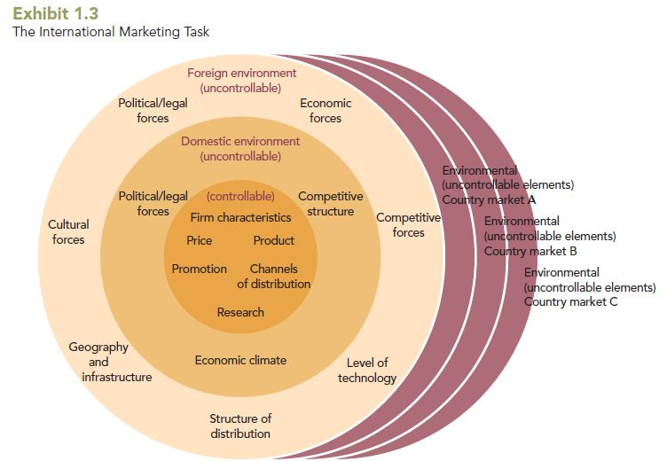
The International Marketing Task

Slide 4
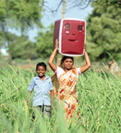
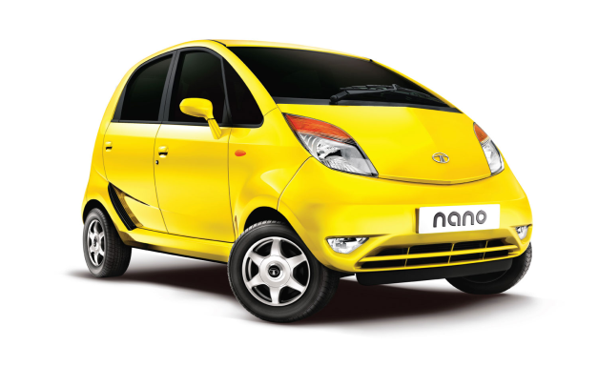
Bottom of the Pyramid Markets (BOP)
4 billion people
$1,200 annual income
Dispersed across countries
Relatively ignored by marketers
The poor have no money
The poor do not want to “waste” money on nonessential goods.
The good sold in developing markets are already inexpensive.
They do not know how to use technology
Global companies are exploiting the poor

Slide 5
Marketing to the Bottom of the Pyramid
What are general considerations needed to develop a product for the BOP market segment?
Providing infrastructure for products to function properly,
Design products to function in local areas with inadequate product support.
Package products in salable sizes.
Examine manufacturing costs to be able to lower prices.
Provide credit in a market where credit purchases are not traditional.
Devise distribution strategies to gain market penetration to small and geographically scattered villages.
Work with local self-help groups to bring products to the BOP

Slide 6


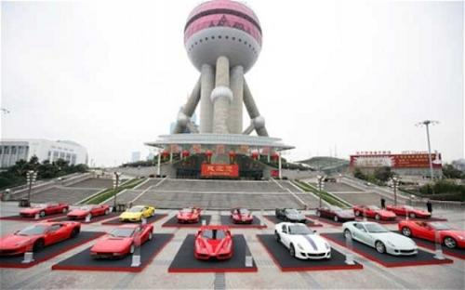


Economic Development & Marketing
As countries prosper and their people are exposed to new ideas through global communications new patterns of consumer behavior emerge.

Slide 7
Integrated Marketing Communications

Slide 8
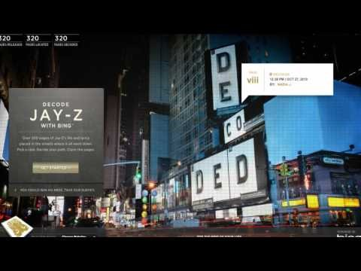
Integrated Marketing Communications
Results
Customers
Communication Channel
Notes:
Bing | Decode Jay-Z Case Study (3:02)
https://www.youtube.com/watch?v=XNic4wf8AYg

Slide 9
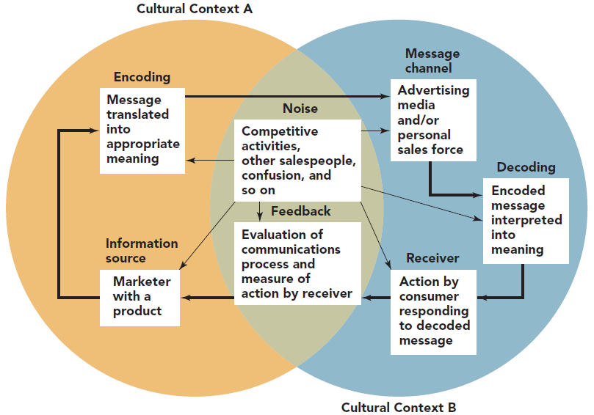
The Communication Process Model
Noise:
-Psychological
-Physical
-Physiological
-Semantic
Advertising Messages must be sent in an Understandable and Meaningful way

Slide 10
Interactive
Personal selling
Sales promotions (e.g., contests)
Direct marketing (e.g., telemarketing)
Direct marketing (e.g., mobile marketing)
Online marketing (e.g., blogs, social media
Offline
Advertising
Sales promotions (e.g., coupons)
Public relations
Direct marketing (e.g., catalogs)
Direct marketing (e.g., e-mail marketing)
Online
Passive

Slide 11
The AIDA Model
Awareness
Interest
Think
Desire
Feel
Action
Do

Slide 12


Awareness
Senders first must gain the attention
A multichannel approach increases the likelihood the message will be received
Awareness -> Action?

Slide 13
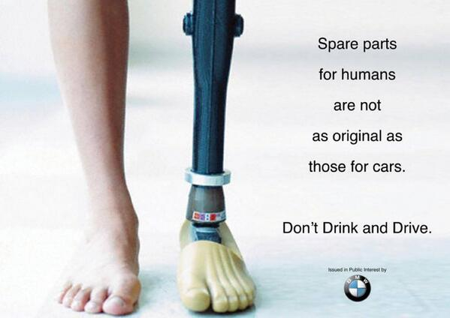



Interest
After awareness comes persuasion
The customer must want to further investigate the product or service
Behavioral
Attitude
Physical

Slide 14

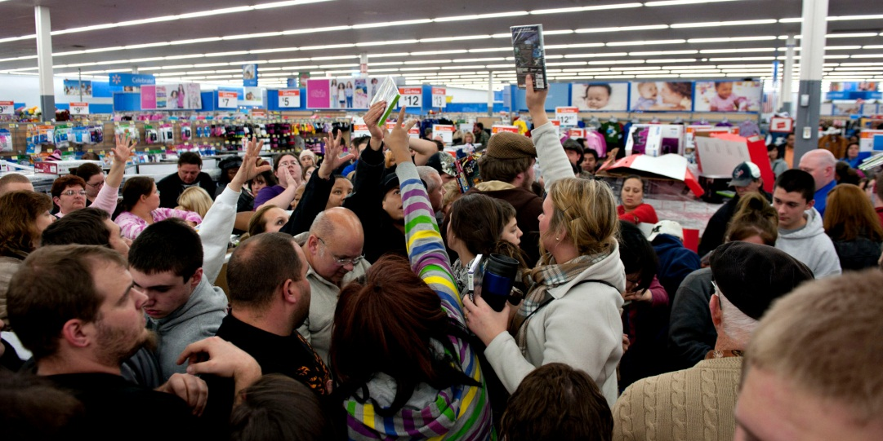
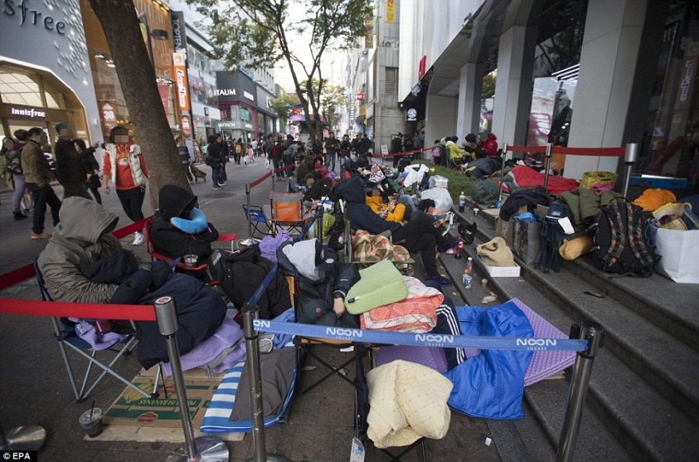
Desire & Action
I like it
I want it

Slide 15

Take Away for Today
Improving Lives through Socially Responsible Marketing
Opportunities in the BOP
The Complicated Process of Communication
Make sure messages are Understandable and Meaningful so they resonate with the targeted audience.
Integration of communication channel messages is key to making sure our messages are “decoded” appropriately.

Slide 16

Next Class
Integrated Marketing Communications Cont…
Advertising, PR & Promotions

